Slide 1
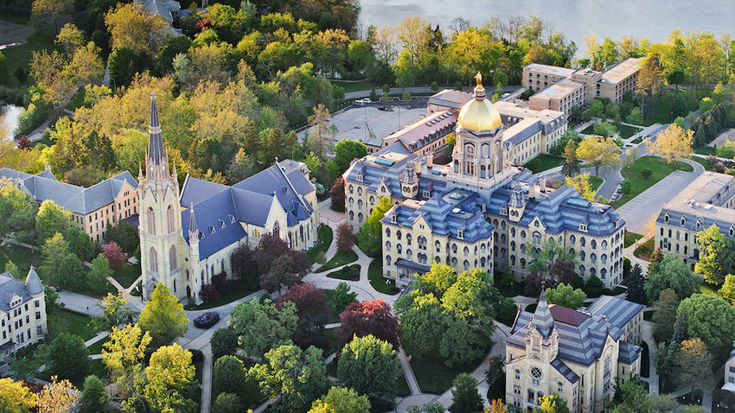


Slide 2

In a letter to the campus community today, Fr. Jenkins announced that the University’s limited number of tickets to the first U.S. presidential debate on Tuesday, Sept. 29, will be allocated exclusively to currently enrolled Notre Dame students.

Slide 3
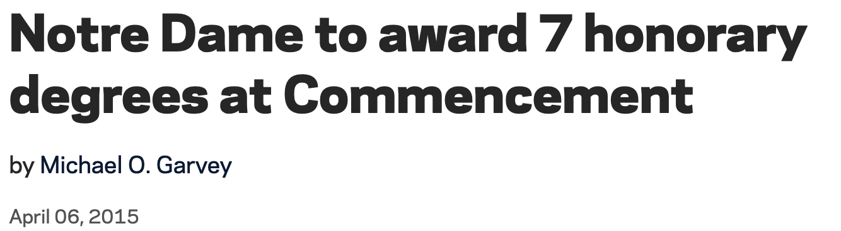


Slide 4

Making Decisions with Structures from Data
DM² Lab
Meng Jiang, Ph.D.
mjiang2@nd.edu
Computer Science & Engineering
University of Notre Dame
Notre Dame, IN 46556, USA

Slide 5

DM²: Data Mining toward Decision Making
Structured Data
ML
Relational databases,
spreadsheets,
information networks, etc.
Data
Decision
User
ML
Predictive models, etc.
Unstructured Data
ML
Structures
News, scientific papers,
technical documents,
social media feeds, etc.
Developing three types of machine learning methods for DM²

Slide 6





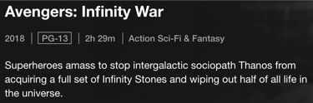
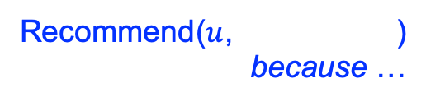
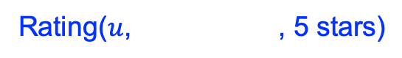
An Example: Movie Recommender System
User
uid | int
num_ratings | int
avg_rating | double
Rating
uid | int
mid | int
rating | int
rating_date | date
Rating($u$, , 5 stars)
Movie
mid | int
release_date | year
avg_rating | double
Decision
Recommend($u$, )
because …
war
force
superhero
universe

Slide 7
Challenges
¹Volume | 100M users 100K movies
²Sparsity | 1B ratings (density 0.01%)
³Variety of Patterns to Learn | Personal preference, Interpersonal influence, Suspicious intention, etc.
⁴Velocity | Time series and dynamics
Structured Data
ML
Data
User
Decision
ML
ML
⁸Interpretability/
User-friendly
Unstructured Data
Structures
⁵Variety of Structures to Extract | Knowledge Graphs/Bases, Taxonomies, Ontologies, Concept hierarchies, etc.
⁶Lack of Supervision | Annotation: Expensive, time-consuming
⁷Veracity | Source reliability, Commonsense

Slide 8

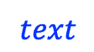
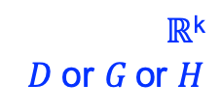
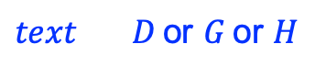
DM²: Three Machine Learning Systems
Representation Learning
Structured Data
$D \text{or} G$ $ℝ$^{k}
Data
User
Decision
Unstructured Data
Structures
Text Generation (NLP)
$$ℝ\text{k}$$
$$D \text{or} G \text{or} H$$
$$text$$
Information Extraction (NLP)
$text$ $D \text{or} G \text{or} H$

Slide 9
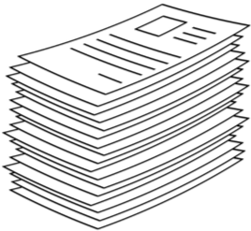
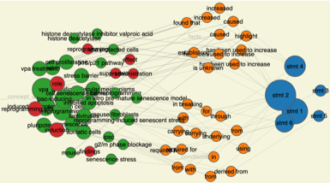
Today’s Example: DM² + Sciences
Publication/Funding application
…
…
author¹
author²
keyword¹
keyword²
ML
Team effectiveness
…
venue
…
affiliation¹
reference¹
reference²
year
Project outcomes
Data
author → investigator
venue → program
+ amount$
Knowledge discovery
ML
Hypothesis generation
Hypothesis validation
Scientific literature
Scientific knowledge graph
http://biokgs.com/

Slide 10
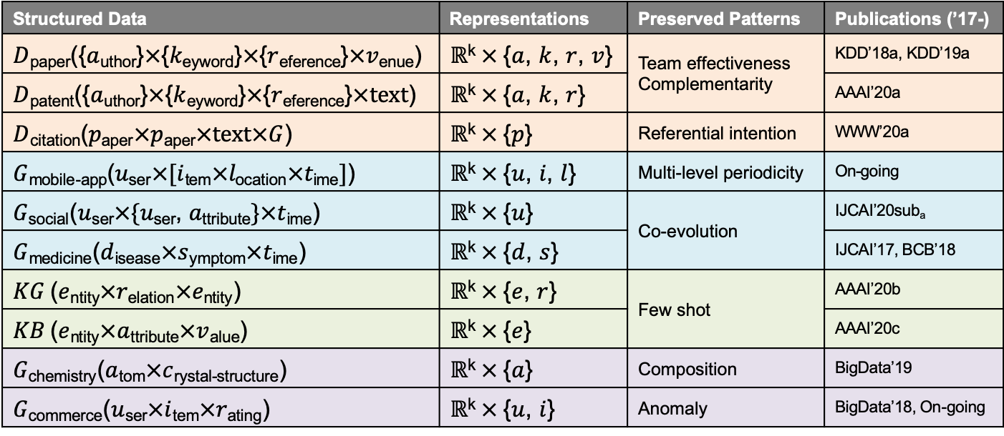
(1) Learning Representations from Structures
Structured Data | Representations | Preserved Patterns | Publications (’17-)
$D$_{paper}({$a$_{uthor}}$×${$k$_{eyword}}$×${$r$_{eference}}$×v\text{enue}$) | $ℝ$^{k}$×${$a$, $k$, $r$, $v$} | Team effectiveness Complementarity | KDD’18a, KDD’19a
$D$_{patent}({$a$_{uthor}}$×${$k$_{eyword}}$×${$r$_{eference}}$×\text{text}$) | $ℝ$^{k}$×${$a$, $k$, $r$} |  | AAAI’20a
$D$_{citation}($p$_{aper}$×p$_{aper}$×\text{text}×G$) | $ℝ$^{k}$×${$p$} | Referential intention | WWW’20a
$G$_{mobile-app}($u$_{ser}$×[i$_{tem}$×l\text{ocation}×t\text{ime}]$) | $ℝ$^{k}$×${$u$, $i\text{,} l$} | Multi-level periodicity | On-going
$G$_{social}($u$_{ser}$×\{u$_{ser}, $a\text{ttribute}\}×t$_{ime}) | $ℝ$^{k}$×${$u$} | Co-evolution | IJCAI’20sub_{a}
$G$_{medicine}($d$_{isease}$×s$_{ymptom}$×t$_{ime}) | $ℝ$^{k}$×${$d$, $s$} |  | IJCAI’17, BCB’18
$KG$ ($e$_{ntity}$×r$_{elation}$×e\text{ntity}$) | $ℝ$^{k}$×${$e$, $r$} | Few shot | AAAI’20b
$KB$ ($e$_{ntity}$×a$_{ttribute}$×v$_{alue}) | $ℝ$^{k}$×${$e$} |  | AAAI’20c
$G$_{chemistry}($a$_{tom}$×c$_{rystal-structure}) | $ℝ$^{k}$×${$a$} | Composition | BigData’19
$G$_{commerce}($u$_{ser}$×i$_{tem}$×r$_{ating}) | $ℝ$^{k}$×${$u$, $i$} | Anomaly | BigData’18, On-going

Slide 11
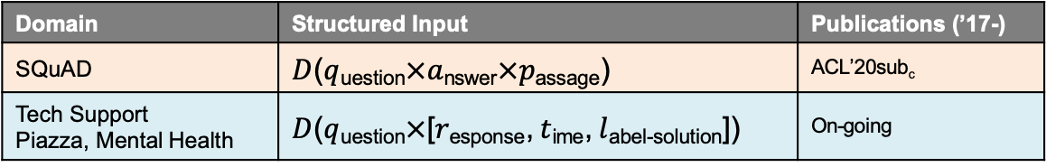
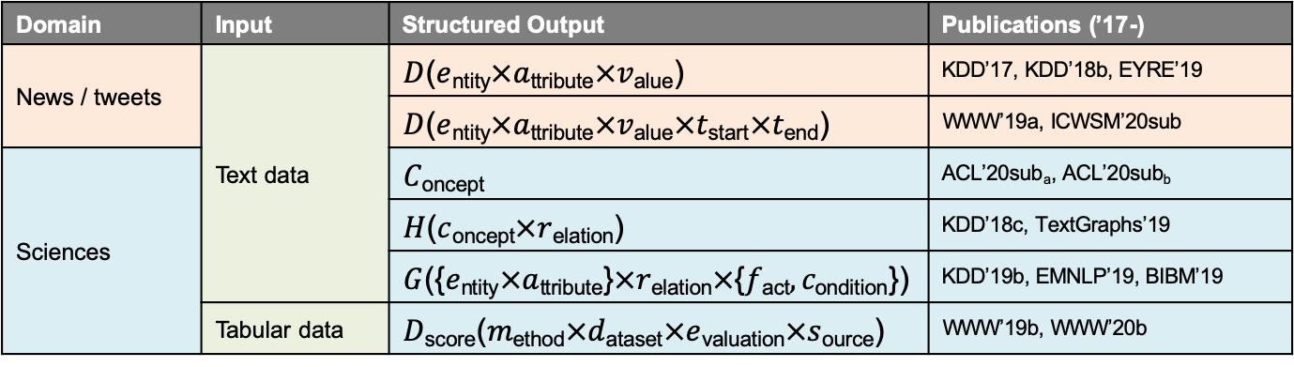
(2) Extracting Structures from Text Corpora
Domain | Input | Structured Output | Publications (’17-)
News / tweets | Text data | $D$($e$_{ntity}$×a$_{ttribute}$×v$_{alue}) | KDD’17, KDD’18b, EYRE’19
 |  | $D$($e$_{ntity}$×a$_{ttribute}$×v$_{alue}$×t$_{start}$×t$_{end}) | WWW’19a, ICWSM’20sub
Sciences |  | $C$_{oncept} | ACL’20sub_{a}, ACL’20sub_{b}
 |  | $H$($c$_{oncept}$×r$_{elation}) | KDD’18c, TextGraphs’19
 |  | $G$({$e$_{ntity}$×a$_{ttribute}}$×r\text{elation}×\text{\{}f\text{act}, c\text{ondition}\text{\}}$) | KDD’19b, EMNLP’19, BIBM’19
 | Tabular data | $D$_{score}($m$_{ethod}$×d$_{ataset}$×e$_{valuation}$×s$_{ource}) | WWW’19b, WWW’20b
(3) Generating Text from Structures
Domain | Structured Input | Publications (’17-)
SQuAD | $D$($q$_{uestion}$×a$_{nswer}$×p$_{assage}) | ACL’20sub_{c}
Tech Support Piazza, Mental Health | $D$($q$_{uestion}$×\text{[}r$_{esponse}, $t$_{ime}, $l$_{abel-solution}]) | On-going

Slide 12

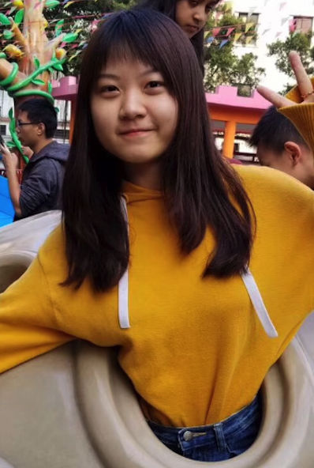


Acknowledgements
Daheng
Wang¹
Tong
Zhao¹
Xueying
Wang²
Qingkai
Zeng²
Wenhao
Yu³
Mengxia
Yu³
Tianwen
Jiang²
¹R.L. ²I.E. ³T.G.

Slide 13
Outline
TUBE: Embedding Behavior Outcomes for Predicting Success (KDD’19a)
Daheng Wang, Tianwen Jiang, Nitesh V. Chawla, Meng Jiang
The Role of “Condition”: A Novel Scientific Knowledge Graph Representation and Construction Model (KDD’19b)
Tianwen Jiang, Tong Zhao, Bing Qin, Ting Liu, Nitesh V. Chawla, Meng Jiang
Experimental Evidence Extraction in Data Science with Hybrid Table Features and Ensemble Learning (WWW’20)
Wenhao Yu, Wei Peng, Yu Shu, Qingkai Zeng, Meng Jiang

Slide 14
Outline
TUBE: Embedding Behavior Outcomes for Predicting Success (KDD’19a)
Daheng Wang, Tianwen Jiang, Nitesh V. Chawla, Meng Jiang
The Role of “Condition”: A Novel Scientific Knowledge Graph Representation and Construction Model (KDD’19b)
Tianwen Jiang, Tong Zhao, Bing Qin, Ting Liu, Nitesh V. Chawla, Meng Jiang
Experimental Evidence Extraction in Data Science with Hybrid Table Features and Ensemble Learning (WWW’20)
Wenhao Yu, Wei Peng, Yu Shu, Qingkai Zeng, Meng Jiang

Slide 15
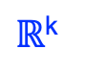
Learning Representations of Components
Project outcome
venue
learning
…
aggregation
?
project
reference²
reference¹
Predictive Model
outcome
?
keyword¹
?
?
author²
$ℝ$^{k}
author¹
Team effectiveness

Slide 16
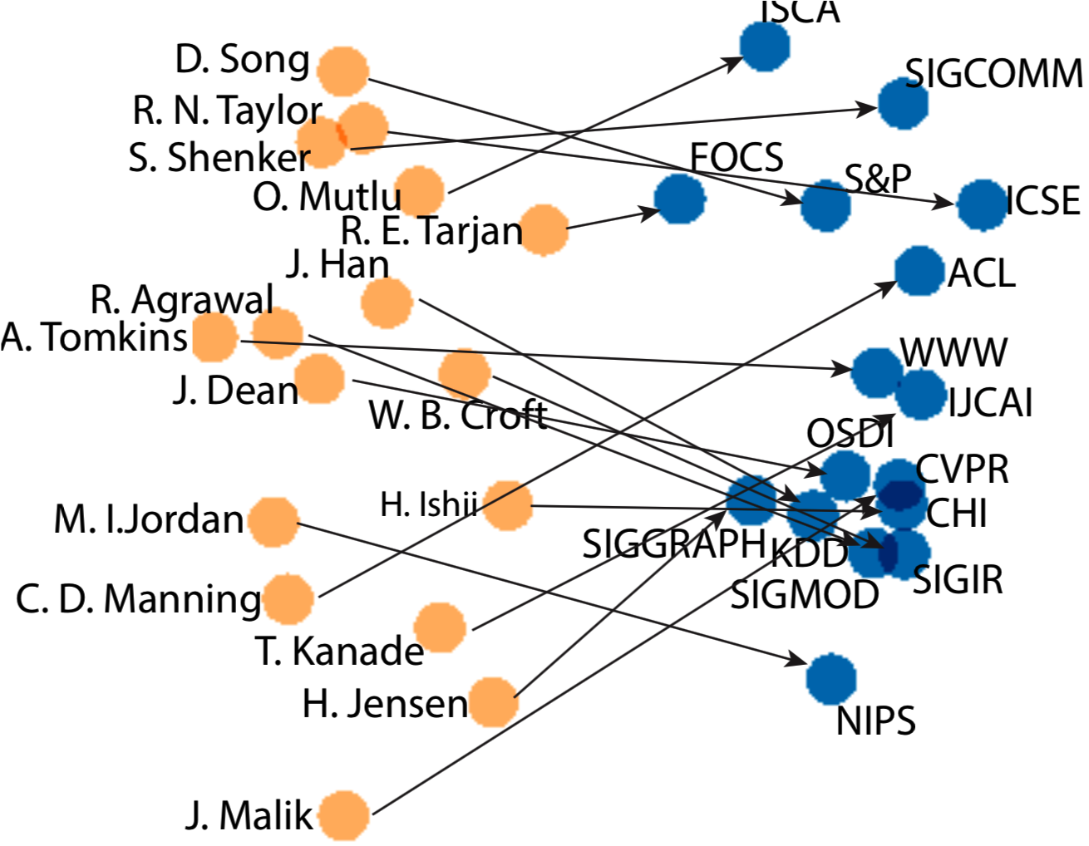
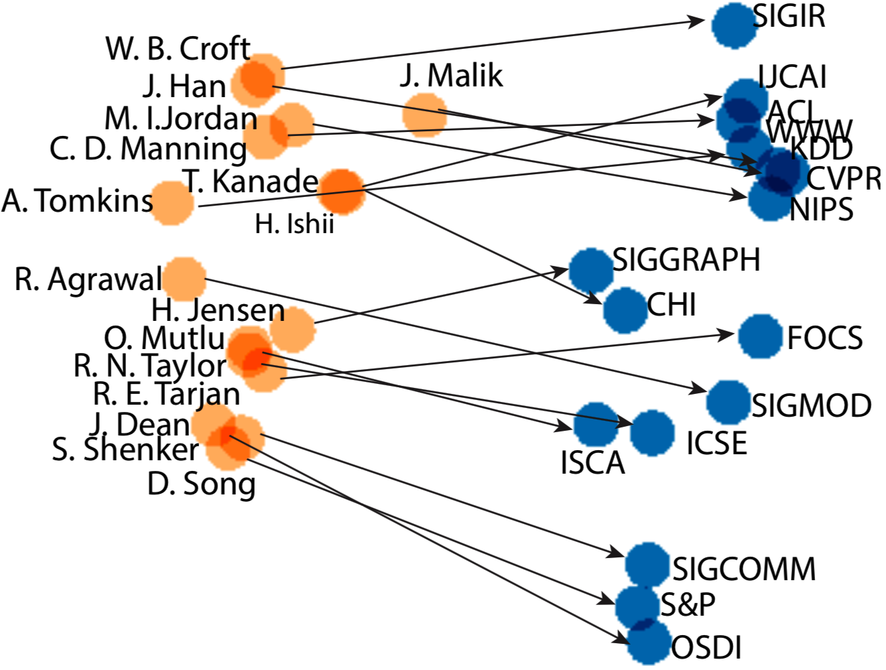
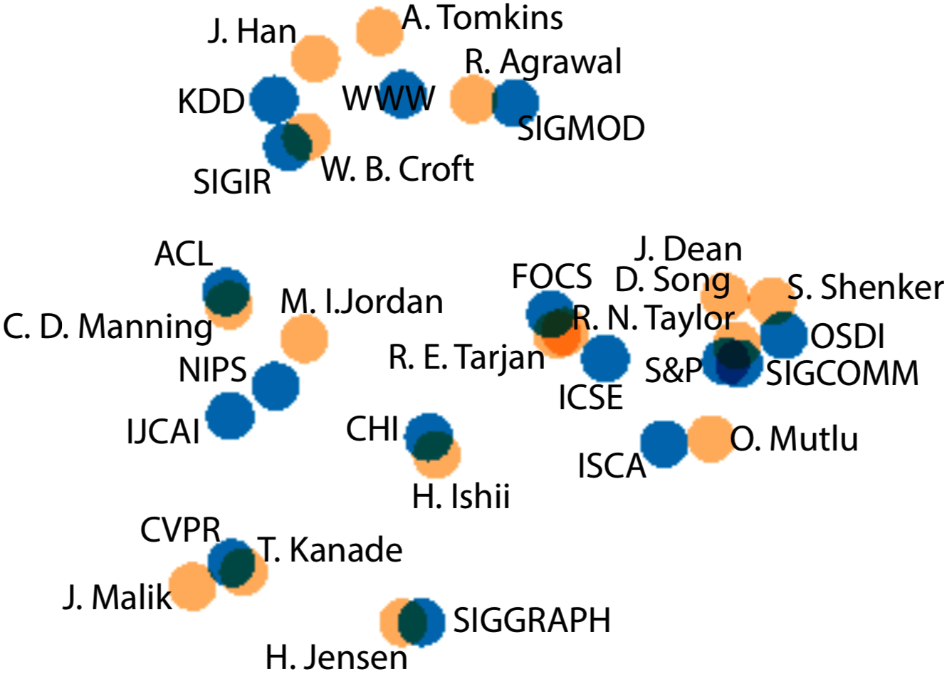
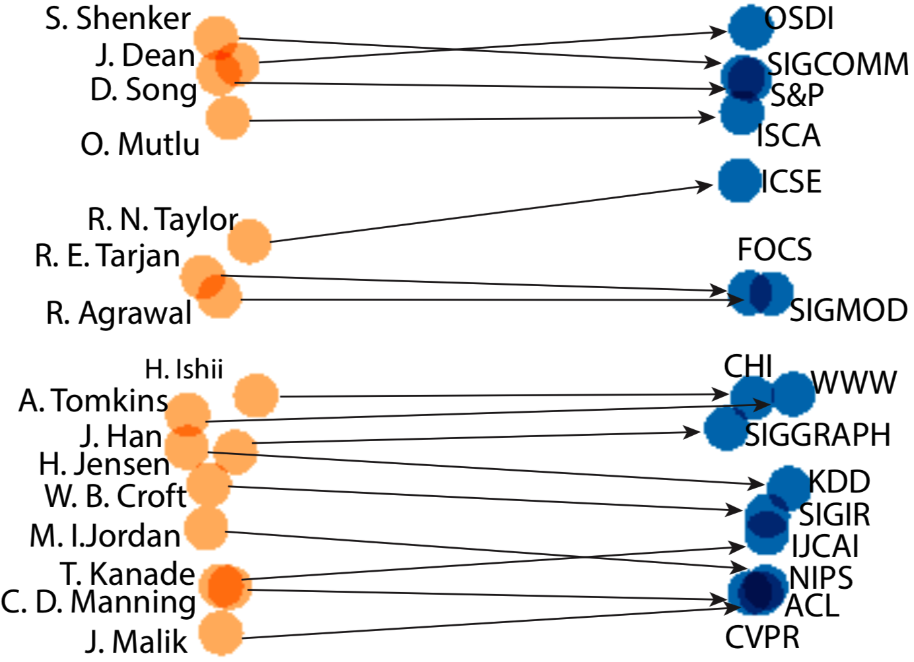
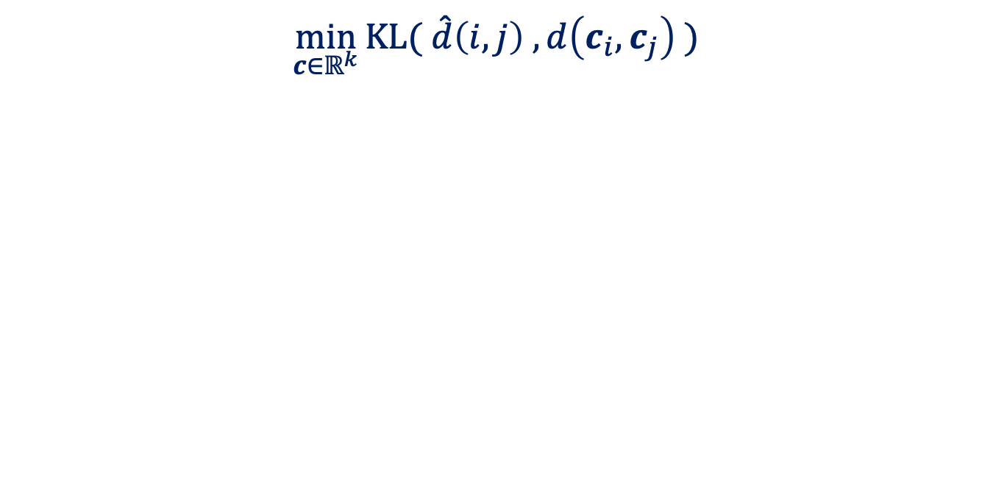
Related Work: Similarity-based R.L.
$$\min_{c{∈ℝ}^{k}}{KL( \hat{d}\left(i,j\right) , d\left(c_{i},c_{j}\right) )}$$
DeepWalk (KDD’14)
node2vec (KDD’16)
PTE (KDD’15)
metapath2vec (KDD’17)
metapath2vec++
(KDD’17)

Slide 17



Complementarity Learning
success
Members that have complementary skills in a successful project
Preserving the complementary relationships in the low-dimensional representations
Similarity learning

Slide 18
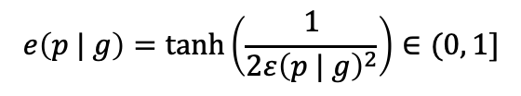
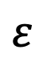
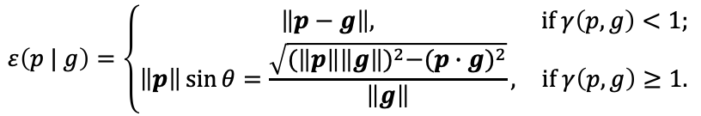
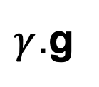
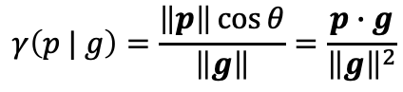
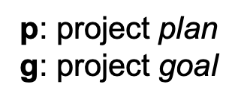
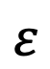
Modeling Plan Effectiveness
p₂
$\text{p}$: project plan
g: project goal
$$ε$$
$γ$.g
Project achievement:
$$γ\left(p | g\right)=\frac{\left\|p\right\|\cos{θ}}{\left\|g\right\|}=\frac{p∙g}{{\left\|g\right\|}^{2}}$$
g
$$ε$$
Distance to success:
$$ε\left(p | g\right)=\left\{\begin{matrix}\left\|p−g\right\|, & if γ\left(p,g\right)<1; \\ \left\|p\right\|\sin{θ}=\frac{\sqrt{{(\left\|p\right\|\left\|g\right\|)}^{2}−{(p∙g)}^{2}}}{\left\|g\right\|}, & if γ\left(p,g\right)≥1.\end{matrix}\right.$$
p₁
θ₂
θ₁
Plan effectiveness:
$$e\left(p | g\right)=\tanh\left(\frac{1}{2{ε\left(p | g\right)}^{2}}\right)∈(0, 1]$$
O

Slide 19
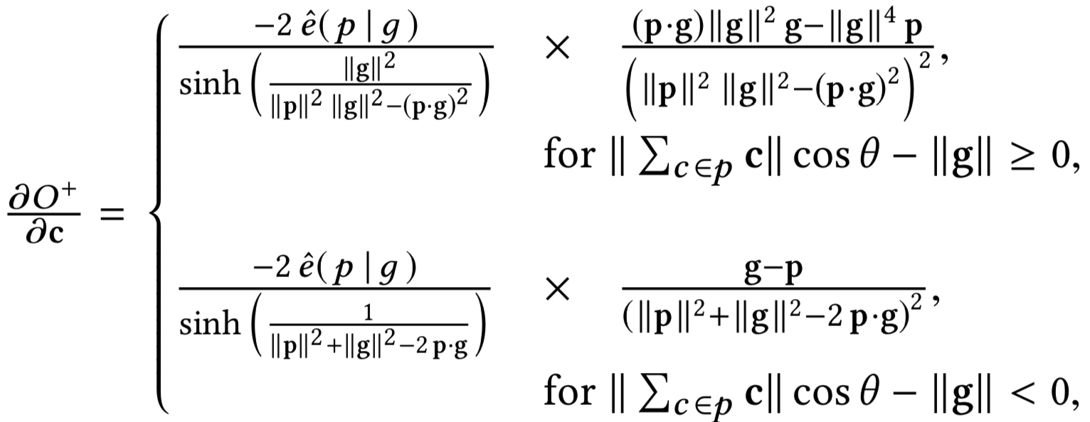
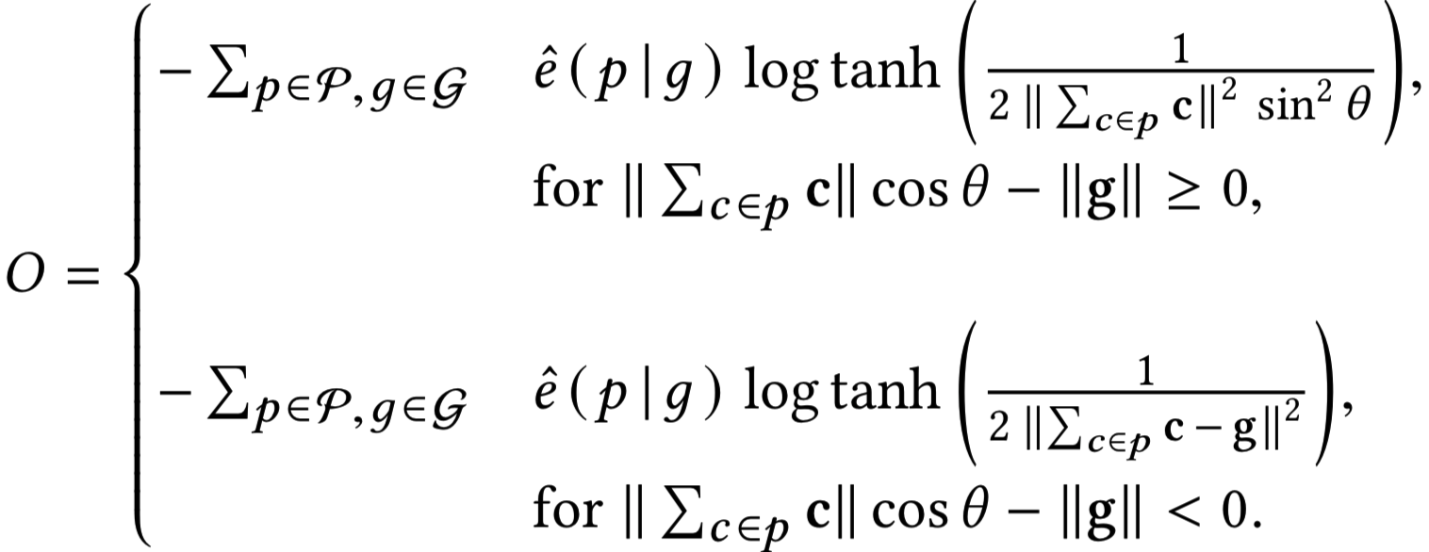
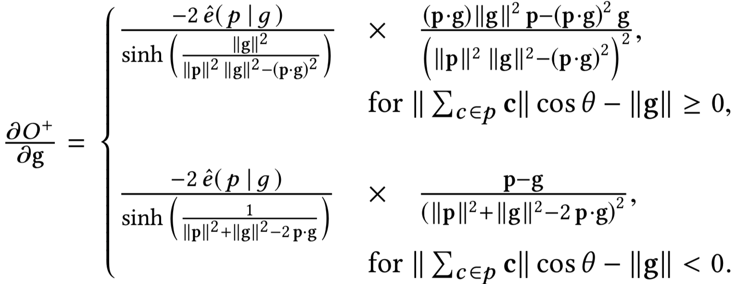
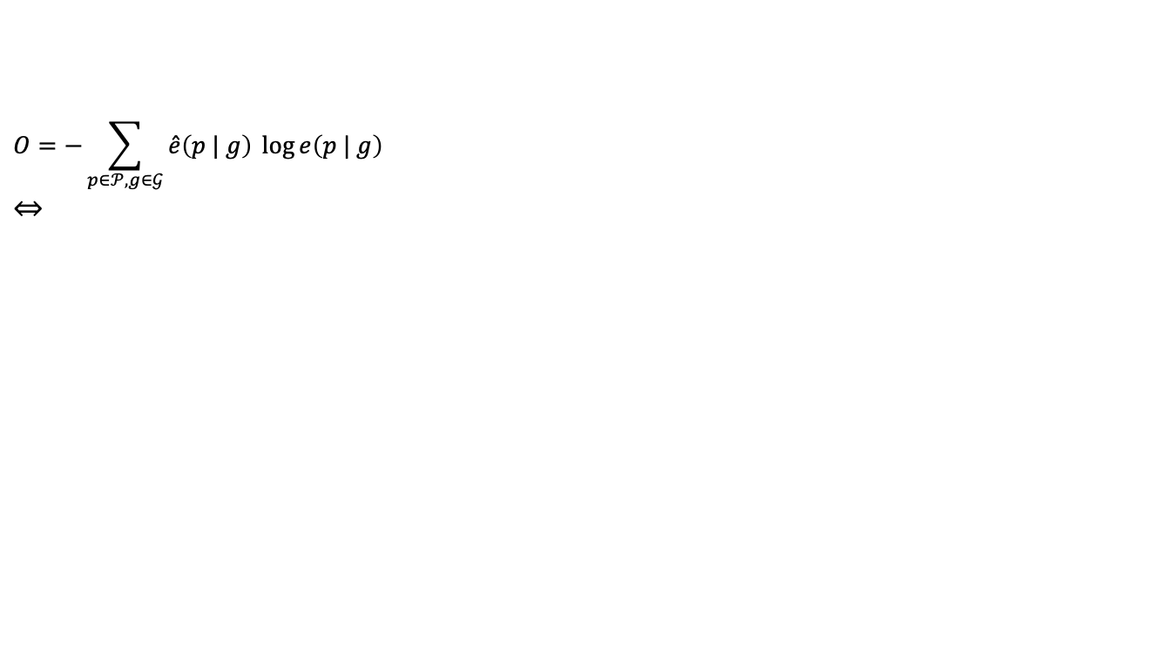
Optimization
$$O=−\sum_{p∈𝒫,g∈𝒢}{\hat{e}\left(p | g\right) \log{e\left(p | g\right)}}$$
$$⇔$$

Slide 20
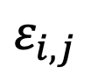
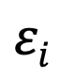
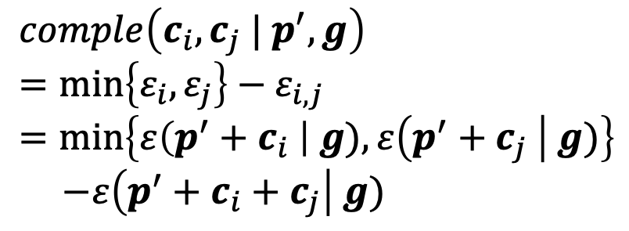
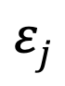
Quantifying Complementarity
g
$$ε_{i,j}$$
$$εi$$
$$εj$$
$$comple\left(c_{i},c_{j} | p^{′},g\right)$$
$$=\min\left\{ε_{i},ε_{j}\right\}−ε_{i,j}$$
$$=\min\left\{ε\left(p^{′}+c_{i} \right| g),ε\left(p^{′}+c_{j} \right| g)\right\}$$
$−ε\left(p^{′}+c_{i}+c_{j}\right| g)$
p'+c_{i}
p'+c_{i}+c_{j}
p'+c_{j}
p'
O

Slide 21
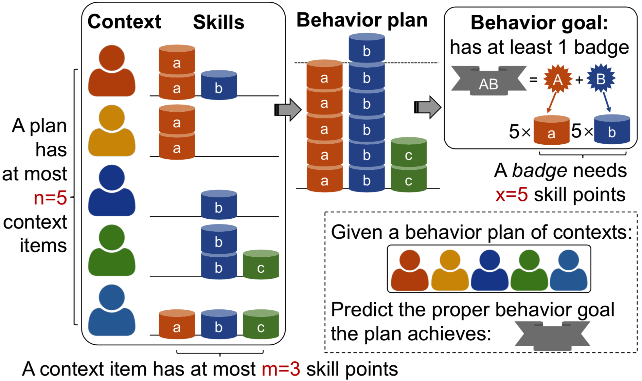
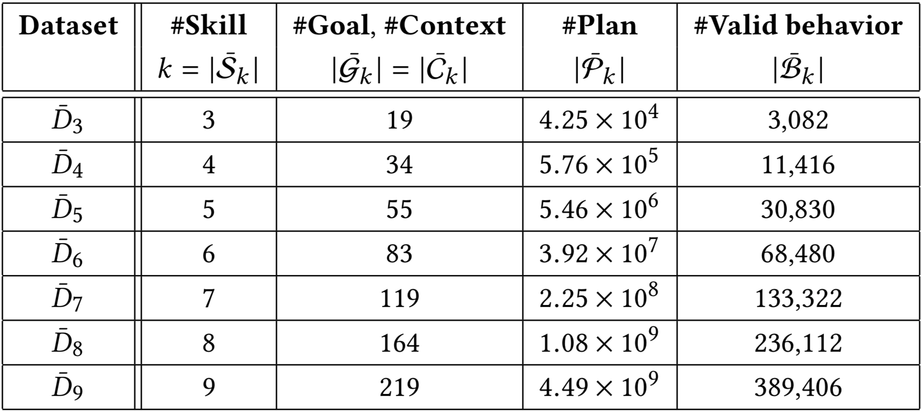
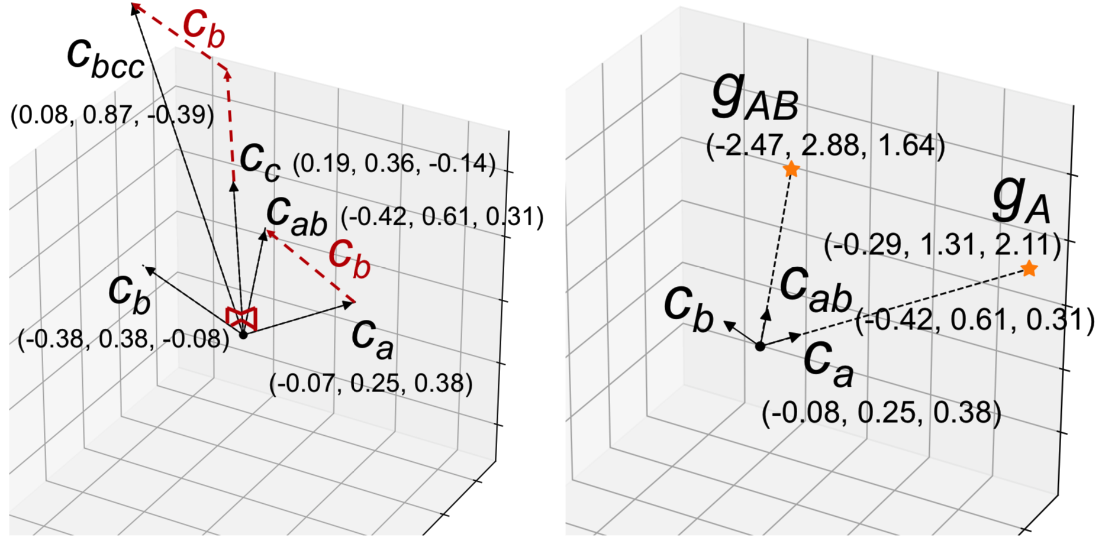
Evaluation: Synthetic Data

Slide 22
Evaluation: Academic Data
*HMR = Harmonic Mean of Ranks | Venue |  | Author |  | Keyword |  | Reference
 | R@10 | HMR* | R@10 | HMR | R@10 | HMR | R@10 | HMR
LINE (Tang et al. WWW’15) | 3.88 | 50. | 0.28 | 627. | 0.21 | 569. | 0.05 | 2773.
node2vec (Grover and Leskovec KDD’16) | 3.09 | 67. | 0.30 | 840. | 0.36 | 455. | 0.05 | 4032.
VERSE (Tsitsulin et al. WWW’18) | 4.57 | 53. | 0.37 | 667. | 0.42 | 415. | 0.08 | 2555.
BiNE (Gao, et al. SIGIR’18) | 5.13 | 44. | 0.72 | 418. | 0.81 | 218. | 0.12 | 1798.
metapath2vec (Dong, et al. KDD’17) | 5.62 | 42. | 0.81 | 368. | 1.03 | 163. | 0.13 | 1863.
LearnSuc (Wang et al. KDD’18) | 10.06 | 28. | 1.33 | 231. | 0.80 | 199. | 0.15 | 1280.
TUBE (Wang et al. KDD’19) | 14.93 | 12. | 2.96 | 59. | 1.25 | 147. | 0.24 | 650.
 | ↑166% | ↓30 | ↑265% | ↓309 | ↑21% | ↓16 | ↑85% | ↓1148
among
254,402
2,000
103,460
9,962

Slide 23
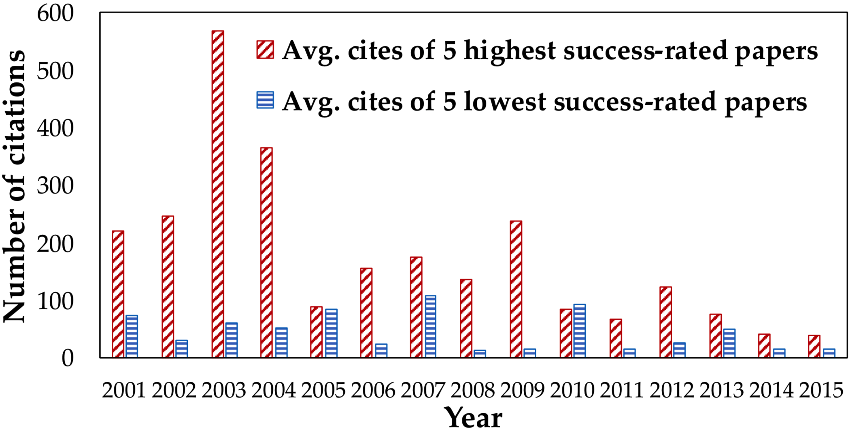
Evaluation: Academic Data (cont.)

Slide 24
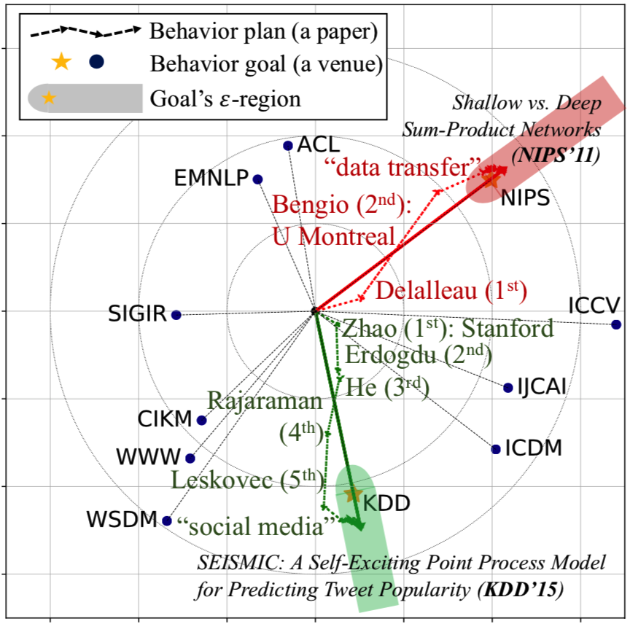
Evaluation: Case Study

Slide 25
Outline
TUBE: Embedding Behavior Outcomes for Predicting Success (KDD’19a)
Daheng Wang, Tianwen Jiang, Nitesh V. Chawla, Meng Jiang
The Role of “Condition”: A Novel Scientific Knowledge Graph Representation and Construction Model (KDD’19b)
Tianwen Jiang, Tong Zhao, Bing Qin, Ting Liu, Nitesh V. Chawla, Meng Jiang
Experimental Evidence Extraction in Data Science with Hybrid Table Features and Ensemble Learning (WWW’20)
Wenhao Yu, Wei Peng, Yu Shu, Qingkai Zeng, Meng Jiang

Slide 26
Taming Sciences with AI
Publication/Funding application
…
…
author¹
author²
keyword¹
keyword²
Team effectiveness
…
venue
…
affiliation¹
reference¹
reference²
year
Project outcomes
Data
author → investigator
venue → program
+ amount$
Knowledge discovery
ML
Hypothesis generation
Hypothesis validation
Scientific literature
Scientific knowledge graph
http://biokgs.com/
Unstructured
Structured

Slide 27
KGs in General Domain: IE
Given “LeBron James is returning to Miami Heat…”
Find fact tuple: (LeBron James, is returning to, Miami Heat)
is returning to
LeBron James
Miami Heat
Named entities

Slide 28
Science IE: Conditional Statements
“We showed that extracellular acidic pH reduces the activity of TRPV5/V6 channels, whereas alkaline pH increases the activity of TRPV5/V6 channels in Jurkat T cells.”
Fact tuple 1: (extracellular acidic pH, reduces, {TRPV5/V6 channels: activity})
Fact tuple 2: (alkaline pH, increases, {TRPV5/V6 channels: activity})
Condition tuple: (TRPV5/V6 channels, in, Jurkat T cells)
“During T lymphocyte activation as well as production of cytokines, …”
Condition tuple 1: (-, during, {T lymphocyte: activation})
Condition tuple 2: (-, during, {cytokines: production})

Slide 29
Three-Level Scientific KGs
Fact tuple 1: (extracellular acidic pH, reduces, {TRPV5/V6 channels: activity})
Fact tuple 2: (alkaline pH, increases, {TRPV5/V6 channels: activity})
Condition tuple: (TRPV5/V6 channels, in, Jurkat T cells)
fact
Stmt
condition
fact
subj.
obj.
reduces
subj.
obj.
in
subj.
obj.
increases
extracellular acidic pH
alkaline pH
activity
TRPV5/V6 channels
Jurkat T cells

Slide 30
Three-Level Scientific KGs (cont.)
“During T lymphocyte activation as well as production of cytokines, …”
Condition tuple 1: (-, during, {T lymphocyte: activation})
Condition tuple 2: (-, during, {cytokines: production})
fact
Stmt
condition
condition
obj.
during
during
obj.
activation
production
T lymphocyte
cytokines

Slide 31
Sequence Labeling for IE
input
We | showed | that | extracellular | acidic | pH | reduces | the | activity | of | TRPV5/V6 | channels | ,
O | O | O | B-f1C | I-f1C | I-f1C | B-f2P | O | B-f3A | O | B-f3C | I-f3C | O
“Begin”
“Concept”
“Predicate”
“object”
output1
“subject”
“relation”
“Attribute”
“fact”
whereas | alkaline | pH | increases | the | activity | of | TRPV5/V6 | channels | in | Jurkat | T | cells | .
O | O | O | O | O | O | O | O | O | O | O | O | O | O
Fact tuple 1: (extracellular acidic pH, reduces, {TRPV5/V6 channels: activity})

Slide 32
Multi-Output Sequence Labeling
We | showed | that | extracellular | acidic | pH | reduces | the | activity | of | TRPV5/V6 | channels | ,
O | O | O | B-f1C | I-f1C | I-f1C | B-f2P | O | B-f3A | O | B-f3C | I-f3C | O
O | O | O | O | O | O | O | O | O | O | O | O | O
O | O | O | O | O | O | O | O | O | O | O | O | O
whereas | alkaline | pH | increases | the | activity | of | TRPV5/V6 | channels | in | Jurkat | T | cells | .
O | O | O | O | O | O | O | O | O | O | O | O | O | O
O | B-f1C | I-f1C | B-f2P | O | B-f3A | O | B-f3C | I-f3C | O | O | O | O | O
O | O | O | O | O | O | O | B-c1C | I-c1C | B-c2P | B-c3C | I-c3C | I-c3C | O
Fact tuple 1: (extracellular acidic pH, reduces, {TRPV5/V6 channels: activity})
Fact tuple 2: (alkaline pH, increases, {TRPV5/V6 channels: activity})
Condition tuple: (TRPV5/V6 channels, in, Jurkat T cells)

Slide 33
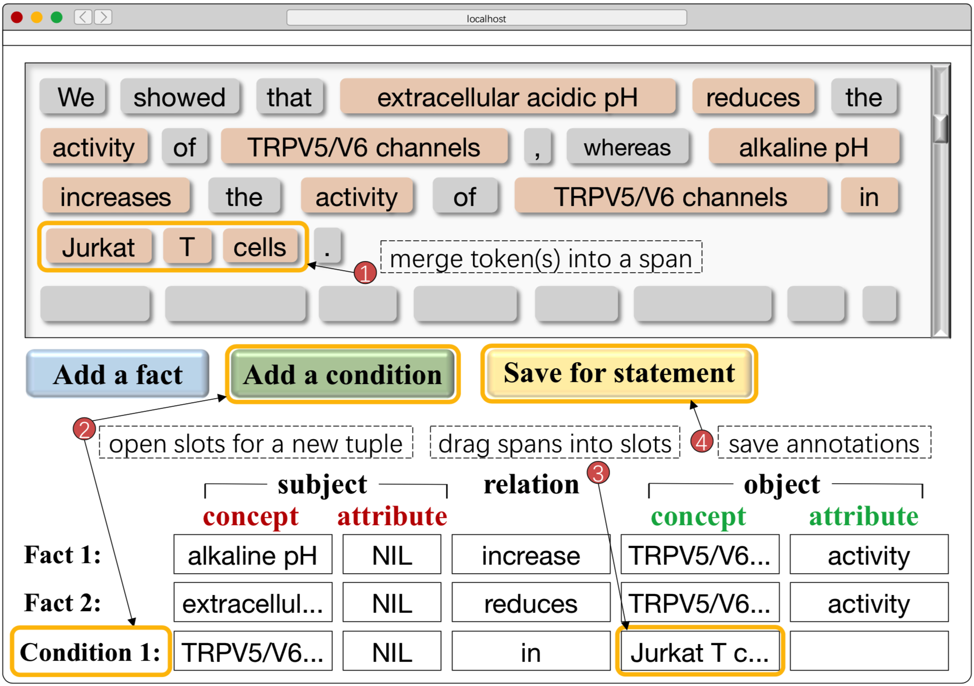
Sequence Labels
B-f1C | I-f1C | B-c1C | I-c1C
B-f1A | I-f1A | B-c1A | I-c1A
B-f2P | I-f2P | B-c2P | I-c2P
B-f3C | I-f3C | B-c3C | I-c3C
B-f3A | I-f3A | B-c3A | I-c3A
O
3 expert annotators
31 PubMed paper abstracts (docs)
> 30 minutes per anno. per doc
336 statement sentences
756 fact tuples
654 condition tuples

Slide 34
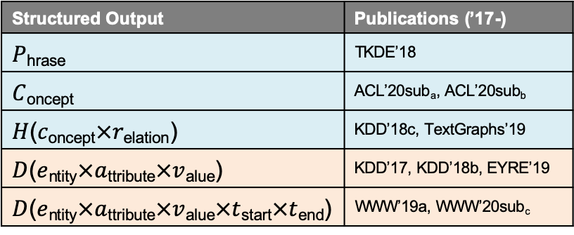
More Signals from Massive Data
Unlabeled data
15,544,338 documents
140,949,399 statement sentences
Feature extraction
Tokenization
Part-of-speech tagging
Phrase mining
Concept detection
Attribute discovery
…
Structured Output | Publications (’17-)
$P$_{hrase} | TKDE’18
$C$_{oncept} | ACL’20sub_{a}, ACL’20sub_{b}
$H$($c$_{oncept}$×r$_{elation}) | KDD’18c, TextGraphs’19
$D$($e$_{ntity}$×a$_{ttribute}$×v$_{alue}) | KDD’17, KDD’18b, EYRE’19
$D$($e$_{ntity}$×a$_{ttribute}$×v$_{alue}$×t$_{start}$×t$_{end}) | WWW’19a, WWW’20sub_{c}

Slide 35
Multi-Input Multi-Output Sequence Labeling
whereas | alkaline | pH | increases | the | activity | of | TRPV5/V6 | channels | in | Jurkat | T | cells | .
NNS | NN | NN | VBZ | DT | NN | IN | NNP | NNS | IN | NNP | NNP | NNS | .
O | B-P | I-P | O | O | B-A | O | B-C | I-C | O | B-C | I-C | I-C | O
O | O | O | O | O | O | O | O | O | O | O | O | O | O
O | B-f1C | I-f1C | B-f2P | O | B-f3A | O | B-f3C | I-f3C | O | O | O | O | O
O | O | O | O | O | O | O | B-c1C | I-c1C | B-c2P | B-c3C | I-c3C | I-c3C | O
MIMO (BiLSTM/BERT)

Slide 36
Evaluation
 | Token Label Prediction (%) |  |  | Tuple Extraction (%)
 | P | R | F1 / fact, cond. | P | R | F1 / fact, cond.
Allennlp OpenIE (Stanovsky et al. 2018) | - | - | - | 42.60 | 38.22 | 40.29 / -, -
Stanford OpenIE (Angeli et al. 2015) | - | - | - | 47.11 | 41.62 | 44.19 / -, -
Structured SVM (Tsochantaridis et al. 2015) | 32.68 | 25.80 | 28.83 / 32.76, 24.71 | 47.62 | 46.15 | 46.87 / 45.01, 48.72
CRF (Lafferty et al. 2001) | 60.07 | 41.92 | 49.37 / 56.23, 41.87 | 65.19 | 62.44 | 63.78 / 64/07, 63.44
BiLSTM-LSTMd (Zheng et al. 2017) | 61.00 | 56.26 | 58.53 / 65.16, 51.78 | 71.57 | 66.55 | 68.97 / 69.51, 68.41
MO (BiLSTM based) | - | - | - | 71.80 | 72.34 | 72.07 / 72.39, 71.73
MIMO (BiLSTM based) | 67.80 | 58.24 | 62.66 / 66.67, 58.58 | 75.35 | 74.67 | 75.01 / 74.91, 75.10
BERT-BiLSTM | 70.07 | 70.19 | 70.13 / 74.30, 65.88 | 78.64 | 73.67 | 76.08 / 76.14, 75.99
MO (BERT based) | - | - | - | 77.38 | 79.19 | 78.27 / 76.74, 79.89
MIMO (BERT based) | 75.91 | 71.08 | 73.41 / 76.01, 70.75 | 81.06 | 80.53 | 80.79 / 79.94, 81.64

Slide 37
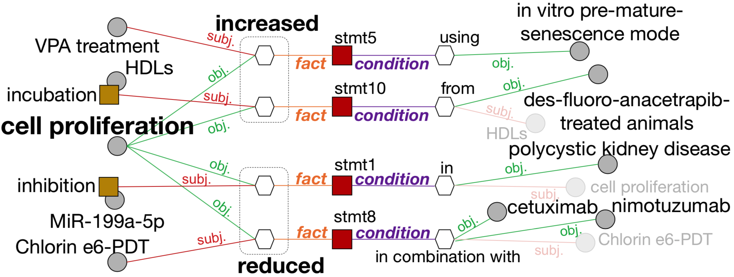
Case Study

Slide 38
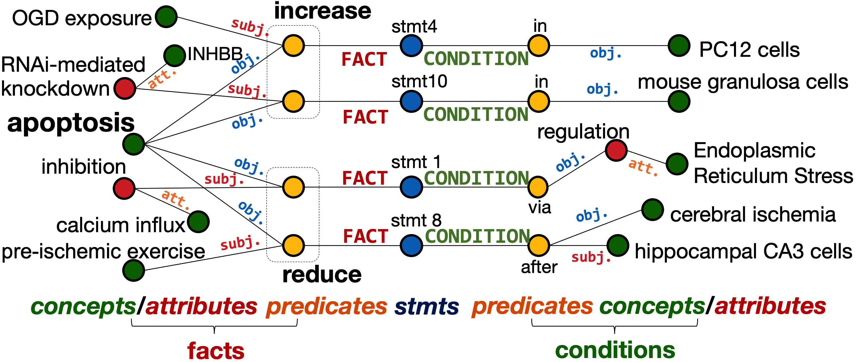
Case Study (cont.)

Slide 39
Intelligent Literature Search

Slide 40
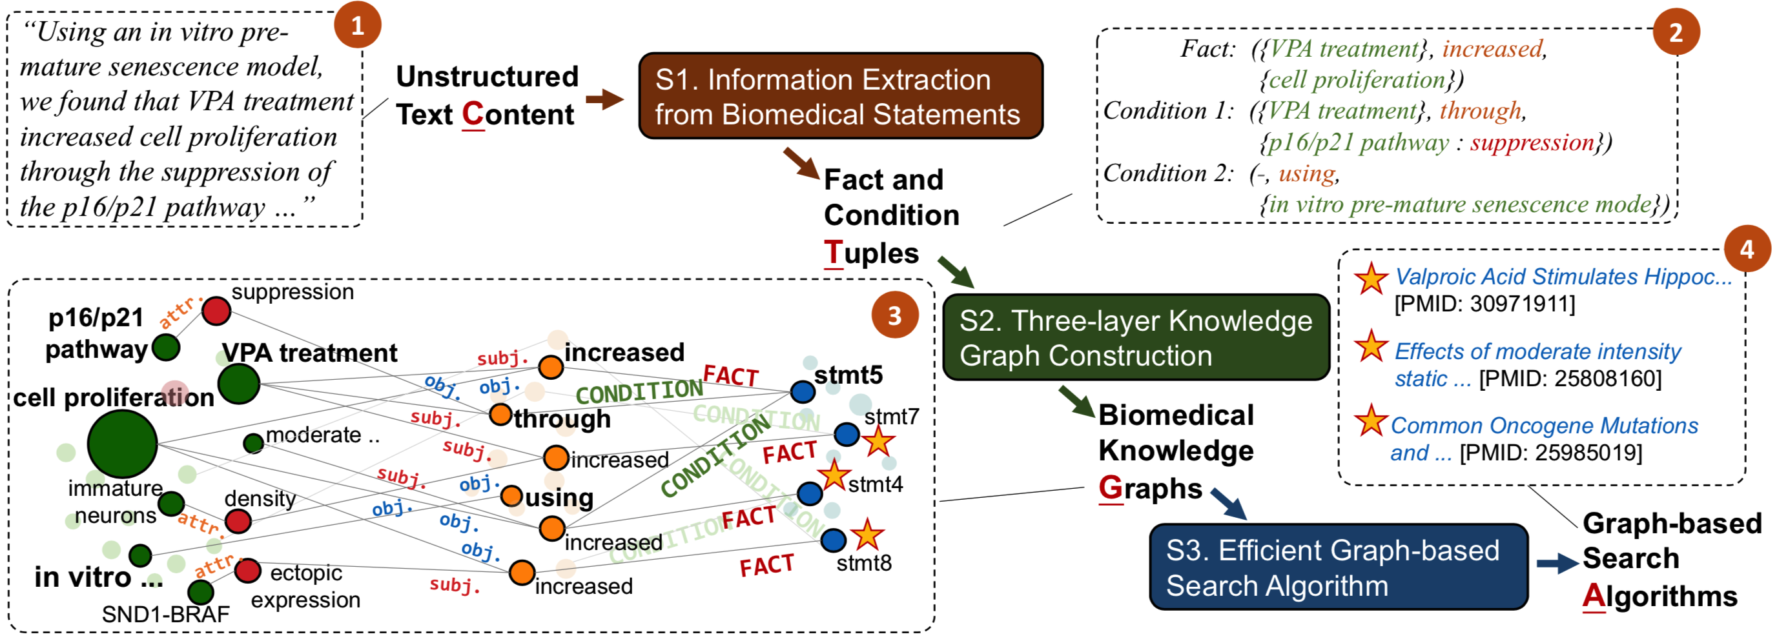
CTGA
 | Rating@1 | Rating@3 | Rating@5 | Kendall’s tau | Preference (%)
PubMed | 4.60 | 3.43 | 2.92 | 68.95 | 34
CTGA | 4.83 | 3.69 | 3.31 | 76.15 | 66
http://biokgs.com/

Slide 41
Outline
TUBE: Embedding Behavior Outcomes for Predicting Success (KDD’19a)
Daheng Wang, Tianwen Jiang, Nitesh V. Chawla, Meng Jiang
The Role of “Condition”: A Novel Scientific Knowledge Graph Representation and Construction Model (KDD’19b)
Tianwen Jiang, Tong Zhao, Bing Qin, Ting Liu, Nitesh V. Chawla, Meng Jiang
Experimental Evidence Extraction in Data Science with Hybrid Table Features and Ensemble Learning (WWW’20)
Wenhao Yu, Wei Peng, Yu Shu, Qingkai Zeng, Meng Jiang

Slide 42
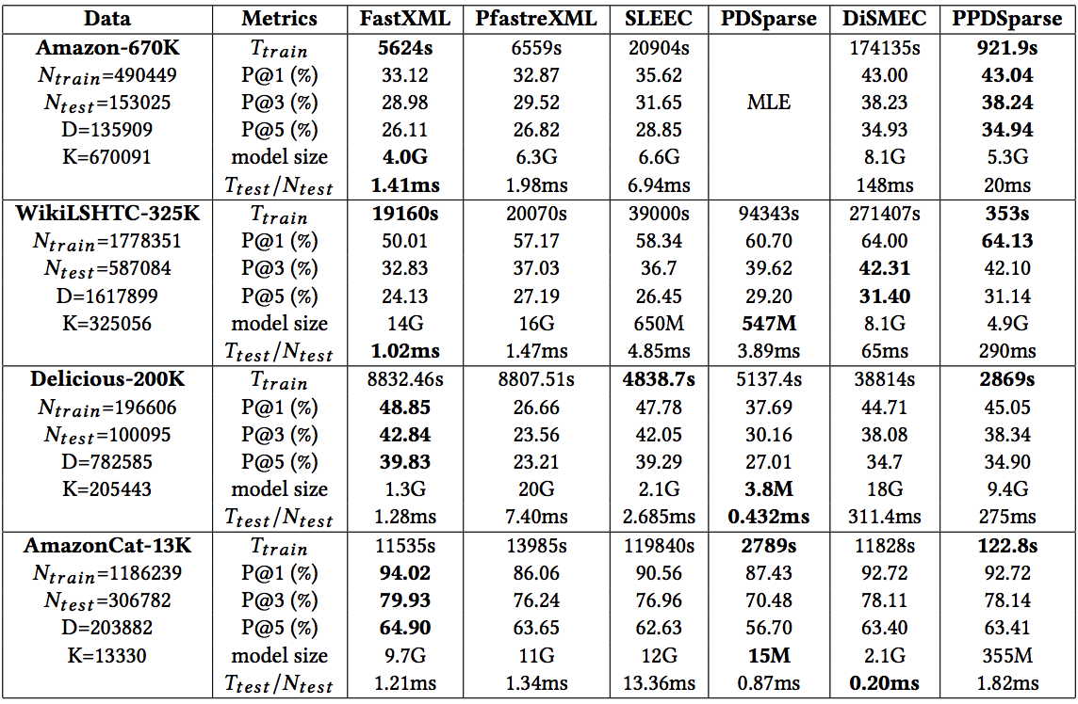
Motivation
PPDSparse: A Parallel Primal-Dual Sparse Method for Extreme Classification
by CMU, UT Austin, Pentuum [KDD 2017]

Slide 43
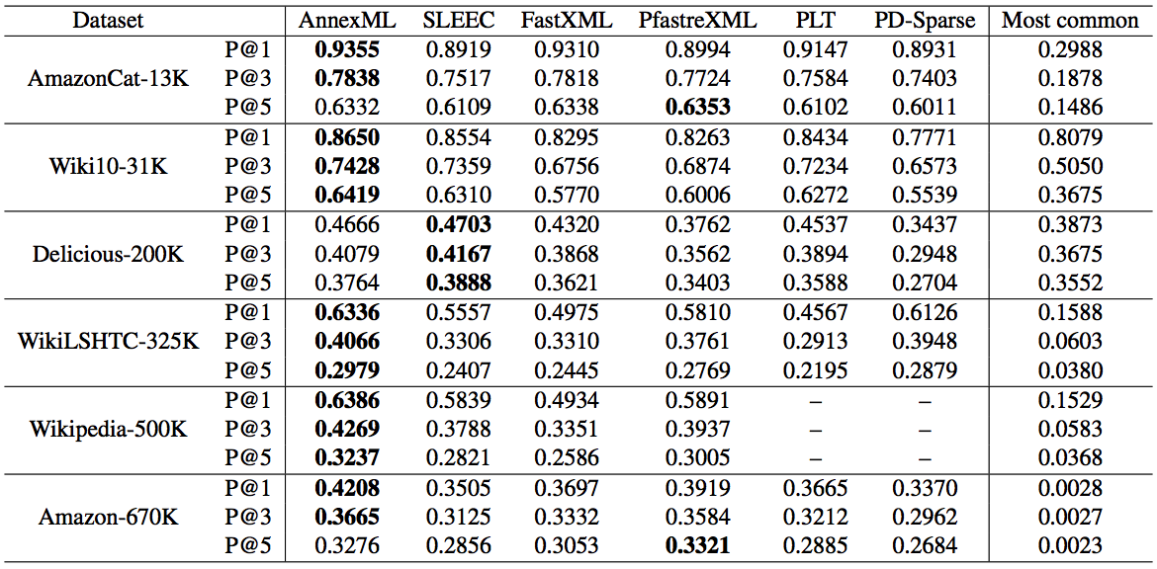
Motivation (cont.)
AnnexML: Approximate Nearest Neighbor Search for Extreme Multi-label Classification
by Yahoo Japan Corporation [KDD 2017]

Slide 44
Motivation (cont.)

Slide 45
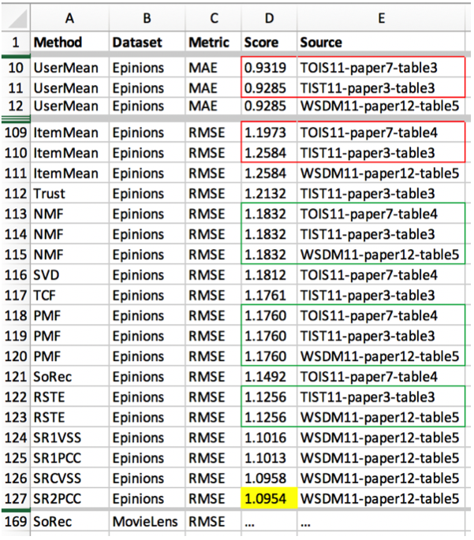
Our Solution & Results
from papers in “Recommender Systems”

Slide 46





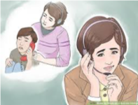
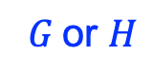


My Last Point: Specialized IA
$$ℝ\text{k}$$
User Modeling:
Behavior Pattern Discovery
Needs
$$G \text{or} H$$
Knowledge Curation:
Domain-Specific KG/KB
Solutions
$$text$$
Response Generation:
Helpfulness, Timeliness
Actions

Slide 47

Intelligent Technical Support
Challenges: Skill gaps, Lack of experience …
Interaction
Perception
Augmented Reality
Response Generation
Knowledge Curation
User Modeling

Slide 48
Take Away
DM² w/ unstructured & structured data
Three types of machine learning methods (and challenges)
Representation learning
Information extraction
Text generation
¹RL: Complementarity learning for predicting project outcomes
²IE: Constructing scientific KGs of facts and conditions
³IE: Building experimental evidence DBs from tabular data
Specialized IA using DM²

Slide 49
References
[KDD’17] Jiang, M., Shang, J., Cassidy, T., Ren, X., Kaplan, L., Hanratty, T., Han, J. “MetaPAD: Meta Patten Discovery from Massive Text Corpora”
[IJCAI’17] Zhao, S., Jiang, M., Yuan, Q., Qin, B., Liu, T., Zhai, C.X. “ContextCare: Incorporating Contextual Information Networks to Representation Learning in Medical Forum Data”
[KDD’18a] Wang, D., Jiang, M., Zeng, Q., Eberhart, Z., Chawla, N.V. “Multi-Type Itemset Embedding for Learning Behavior Success”
[KDD’18b] Jiang, M., Li, Q., Zhang, X., Qu, M., Hanratty, T., Gao, J., Han, J. “TruePIE: Discovering Reliable Patterns in Pattern-Based Information Extraction”
[KDD’18c] Zhang, C., Tao, F., Chen, X., Shen, J., Jiang, M., Sadler, B., Vanni, M., Han, J. “TaxoGen: Constructing Topical Concept Taxonomy by Adaptive Term Embedding and Clustering”
[BCB’18] Zhao, S., Jiang, M., Liu, M., Qin, B., Liu, T. “CausalTriad: Toward Pseudo Causal Relation Discovery and Hypotheses Generation from Medical Text Data”
[BigData’18] Zhao, T., Malir, M., Jiang, M. “Actionable Objective Optimization for Suspicious Behavior Detection on Large Bipartite Graphs”
[KDD’19a] Wang, D., Jiang, T., Chawla, N.V., Jiang, M. “TUBE: Embedding Behavior Outcomes for Predicting Success”
[KDD’19b] Jiang, T., Zhao, T., Qin, B., Liu, T., Chawla, N.V., Jiang, M. “The Role of Condition: A Novel Scientific Knowledge Graph Representation and Construction Model”

Slide 50
References (cont.)
[WWW’19a] Wang, X., Zhang, H., Li, Q., Shi, Y., Jiang, M. “A Novel Unsupervised Approach for Precise Temporal Slot Filling from Incomplete and Noisy Temporal Contexts”
[WWW’19b] Yu, W., Li, Z., Zeng, Q., Jiang, M. “Tablepedia: Automating PDF Table Reading in an Experimental Evidence Exploration and Analytic System”
[EMNLP’19] Jiang, T., Zhao, T., Qin, B., Liu, T., Chawla, N.V., Jiang, M. “Multi-input Multi-output Sequence Labeling for Joint Extraction of Fact and Condition Tuples from Scientific Text”
[BIBM’19] Jiang, T., Zhang, Z., Zhao, T., Qin, B., Liu, T., Chawla, N.V., Jiang, M. “CTGA: Graph-based Biomedical Literature Search”
[BigData’19] Ding, Y., Wang, D., Weninger, T., Jiang, M. “Preserving Composition and Crystal Structure Information of Chemical Compounds in Atomic Embedding”
[EYRE’19] Ma, Y., Zeng, Q., Jiang, T., Cai, L., Jiang, M. “A Study of Person Entity Extraction and Profiling from Classical Chinese Historiography”
[TextGraphs’19] Zeng, Q., Yu, M., Yu, W., Xiong, J., Shi, Y., Jiang, M. “Faceted Hierarchy: A New Graph Type to Organize Scientific Concepts and a Construction Method”
[AAAI’20a] Tang, P., Jiang, M., Xia, N., Pitera, J., Welser, J., Chawla, N.V. “Multi-label Patent Categorization with Non-local Attention-based Graph Convolutional Network”
[AAAI’20b] Yao, H., Zhang, C., Wei, Y., Jiang, M., Wang, S., Chawla, N.V., Li, Z. “Graph Few-shot Learning via Knowledge Transfer”
[AAAI’20c] Zhang, C., Yao, H., Jiang, M., Li, Z., Chawla, N.V. “Few-Shot Knowledge Base Completion”

Slide 51
References (cont.)
[WWW’20a] Yu, W., Yu, M., Zhao, T., Jiang, M. “Identifying Referential Intention with Heterogeneous Contexts”
[WWW’20b] Yu, W., Peng, W., Shu, Y., Zeng, Q., Jiang, M. “Experimental Evidence Extraction in Data Science with Hybrid Table Features and Ensemble Learning”
[ICWSM’20sub] Zhou, Y., Zhao, T., Jiang, M. “A Probabilistic Model with Commonsense Constraints for Pattern-based Temporal Fact Extraction”
[IJCAI’20sub_{a}] Wang, D., Zhao, T., Jiang, T., Chawla, N.V., Jiang, M. “EvoGNN: Modeling Co-evolution of Attributed and Structural Information in Dynamic Networks”
[IJCAI’20sub_{b}] Jiang, T., Zhao, T., Qin, B., Liu, T., Chawla, N.V., Jiang, M. “Canonicalizing Open Knowledge Bases with Multi-layered Meta-graph Neural Network”
[ACL’20sub_{a}] Zeng, Q., Jiang, T., Yu, M., Yu, W., Peng, W., Weninger, T., Jiang, M. “Amending a Popular Dataset and Improving Scientific Entity Recognition with No-Schema Distant Supervision”
[ACL’20sub_{b}] Zeng, Q., Yu, W., Yu, M., Peng, W., Jiang, T., Weninger, T., Jiang, M. “Distant Supervision for Scientific Entity Recognition and Empirical Investigation on Various Options”
[ACL’20sub_{c}] Yu, W., Wu, L., Zeng, Q., Tao, S., Deng, Y., Jiang, M. “Crossing Variational Autoencoders for Answer Retrieval”

Slide 52
Acknowledgements
Daheng
Wang¹
Tong
Zhao¹
Xueying
Wang²
Qingkai
Zeng²
Wenhao
Yu³
Mengxia
Yu³
Tianwen
Jiang²
¹R.L. ²I.E. ³T.G.

Slide 53
Outline (ML + Science)
¹R.L.
Structured Data | Representations | Preserved Patterns | Publications (’17-)
$D$_{paper}({$a$_{uthor}}$×${$k$_{eyword}}$×${$r$_{eference}}$×v\text{enue}$) | $ℝ$^{k}$×${$a$, $k$, $r$, $v$} | Team effectiveness Complementarity | KDD’18a, KDD’19a
[KDD’18a] Wang, D., Jiang, M., Zeng, Q., Eberhart, Z., Chawla, N.V. “Multi-Type Itemset Embedding for Learning Behavior Success”
[KDD’19a] Wang, D., Jiang, T., Chawla, N.V., Jiang, M. “TUBE: Embedding Behavior Outcomes for Predicting Success”
²I.E.
Domain | Input | Structured Output | Publications (’17-)
Biomedicine | Text data | $G$({$e$_{ntity}$×a$_{ttribute}}$×r\text{elation}×\text{\{}f\text{act}, c\text{ondition}\text{\}}$) | KDD’19b, EMNLP’19, BIBM’19
[KDD’19b] Jiang, T., Zhao, T., Qin, B., Liu, T., Chawla, N.V., Jiang, M. “The Role of Condition: A Novel Scientific Knowledge Graph Representation and Construction Model”
[EMNLP’19] Jiang, T., Zhao, T., Qin, B., Liu, T., Chawla, N.V., Jiang, M. “Multi-input Multi-output Sequence Labeling for Joint Extraction of Fact and Condition Tuples from Scientific Text”
²I.E.
Domain | Input | Structured Output | Publications (’17-)
Data Science | Tabular data | $D$_{score}($m$_{ethod}$×d$_{ataset}$×e$_{valuation}$×s$_{ource}) | WWW’19b, WWW’20b
[WWW’19b] Yu, W., Li, Z., Zeng, Q., Jiang, M. “Tablepedia: Automating PDF Table Reading in an Experimental Evidence Exploration and Analytic System”
[WWW’20b] Yu, W., Peng, W., Shu, Y., Zeng, Q., Jiang, M. “Experimental Evidence Extraction in Data Science with Hybrid Table Features and Ensemble Learning”

Slide 54
Outline (GNN)
¹R.L.
Structured Data | Representations | Preserved Patterns | Publications (’17-)
$G$_{commerce}($u$_{ser}$×i$_{tem}$×r$_{ating}) | $ℝ$^{k}$×${$u$, $i$} | Anomaly | On-going
[On-going] Zhao, T., et al. “Learning with Bipartite Graph Anomaly Losses”
[On-going] Zhao, T., et al. “Early Anomaly Detection with Dynamics Prediction”
Structured Data | Representations | Preserved Patterns | Publications (’17-)
$G$_{social}($u$_{ser}$×\{u$_{ser}, $a\text{ttribute}\}×t$_{ime}) | $ℝ$^{k}$×${$u$} | Co-evolution | IJCAI’20sub_{a}
[IJCAI’20sub_{a}] Wang, D., Zhao, T., Jiang, T., Chawla, N.V., Jiang, M. “EvoGNN: Modeling Co-evolution of Attributed and Structural Information in Dynamic Networks”
Structured Data | Representations | Preserved Patterns | Publications (’17-)
$G$_{mobile-app}($u$_{ser}$×[i$_{tem}$×l\text{ocation}×t\text{ime}]$) | $ℝ$^{k}$×${$u$, $i\text{,} l$} | Multi-level periodicity | On-going
[On-going] Wang, D., Jiang, M., Chawla, N.V. “Calendar Graph Neural Networks for Modeling Time Structures in Spatiotemporal User Behaviors”

Slide 55

Outline (IE)
²I.E.
Domain | Input | Structured Output | Publications (’17-)
News / tweets | Text data | $D$($e$_{ntity}$×a$_{ttribute}$×v$_{alue}) | KDD’17, KDD’18b
 |  | $D$($e$_{ntity}$×a$_{ttribute}$×v$_{alue}$×t$_{start}$×t$_{end}) | WWW’19a, ICWSM’20sub
[KDD’17] Jiang, M., Shang, J., Cassidy, T., Ren, X., Kaplan, L., Hanratty, T., Han, J. “MetaPAD: Meta Patten Discovery from Massive Text Corpora”
[KDD’18b] Jiang, M., Li, Q., Zhang, X., Qu, M., Hanratty, T., Gao, J., Han, J. “TruePIE: Discovering Reliable Patterns in Pattern-Based Information Extraction”
[WWW’19a] Wang, X., Zhang, H., Li, Q., Shi, Y., Jiang, M. “A Novel Unsupervised Approach for Precise Temporal Slot Filling from Incomplete and Noisy Temporal Contexts”
[ICWSM’20sub] Zhou, Y., Zhao, T., Jiang, M. “A Probabilistic Model with Commonsense Constraints for Pattern-based Temporal Fact Extraction”
Domain | Input | Structured Output | Publications (’17-)
Sciences | Text data | $C$_{oncept} | ACL’20sub_{a}, ACL’20sub_{b}
[ACL’20sub_{a}] Zeng, Q., Jiang, T., Yu, M., Yu, W., Peng, W., Weninger, T., Jiang, M. “Amending a Popular Dataset and Improving Scientific Entity Recognition with No-Schema Distant Supervision”
[ACL’20sub_{b}] Zeng, Q., Yu, W., Yu, M., Peng, W., Jiang, T., Weninger, T., Jiang, M. “Distant Supervision for Scientific Entity Recognition and Empirical Investigation on Various Options”

